Slide 1
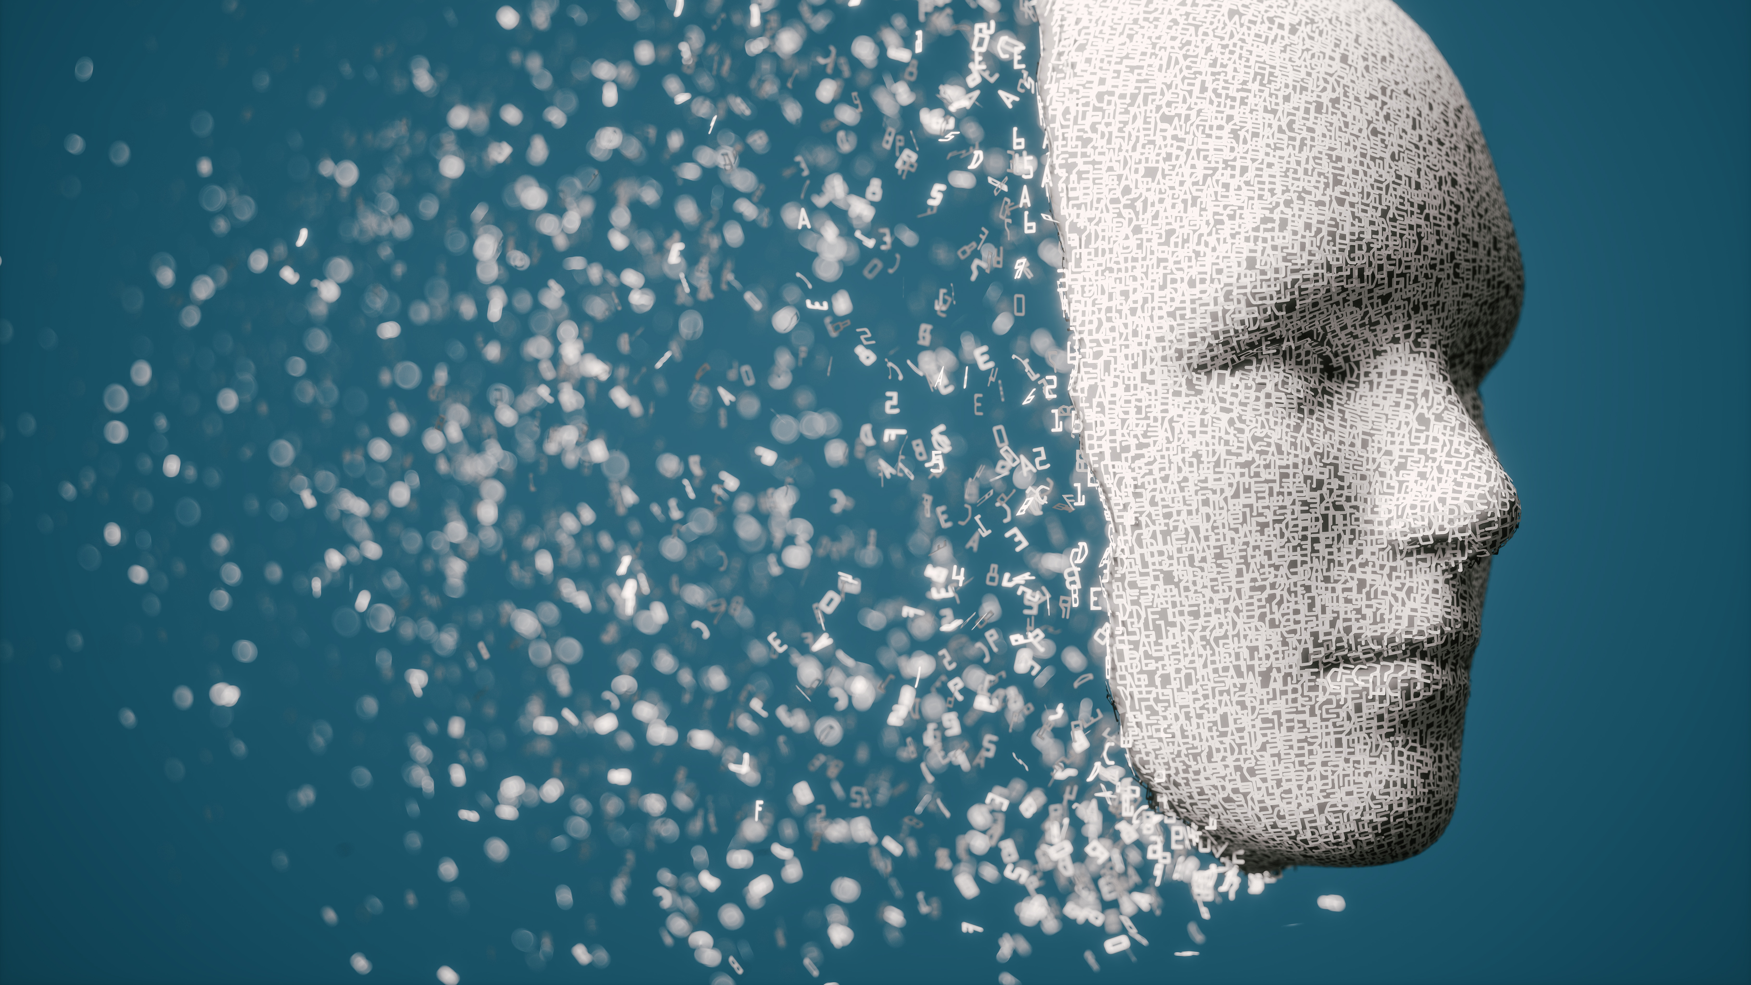
AI and Cybersecurity, Ethical Considerations and Emerging Threats
Date: October 25, 2024
Group Members: Justin, Ashton, Joseph

Slide 2

Defending Against Cyber Threats A Focus on Spear-Phishing
Date: October 25, 2024
By: Justin Greenslade

Slide 3
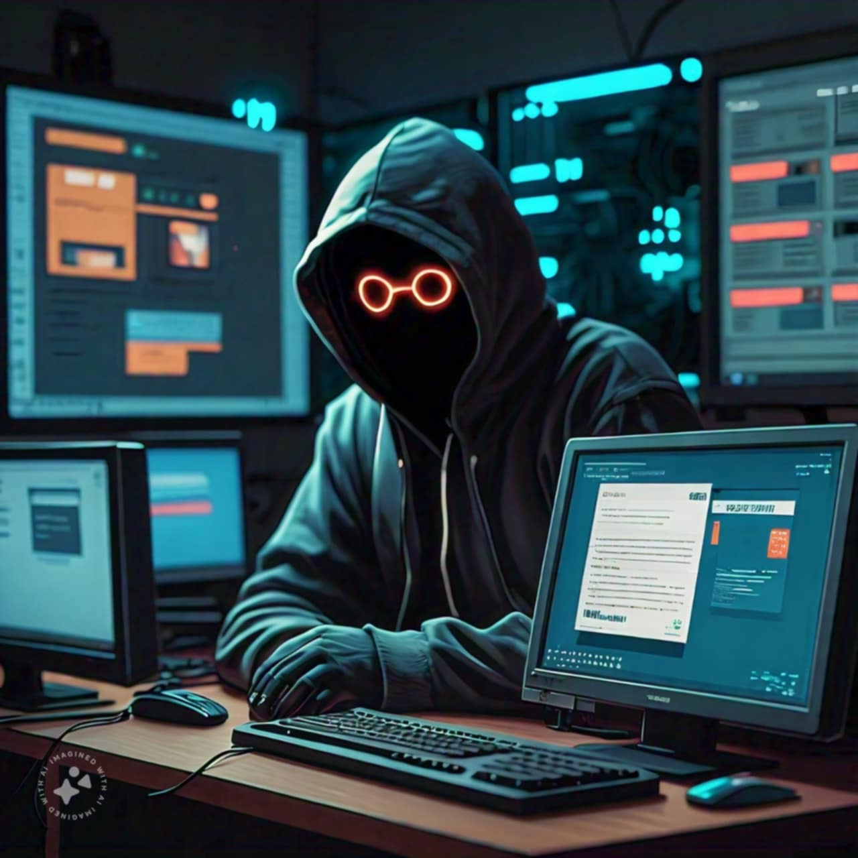
Chinese Hackers Target OpenAI.
Hacker Group: "SweetSpecter.”
Attack Method: Spear-phishing tactics using malicious zip files.
Security Response: Security systems effectively blocked most attacks.

Slide 4
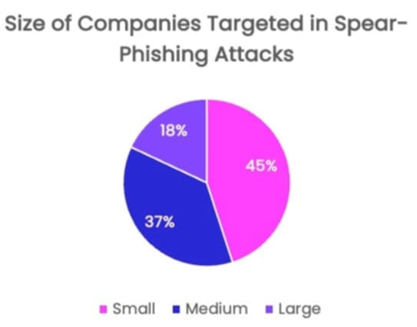
Insights on Spear-Phishing Tactics.
Spear-phishing targets specific individuals or organizations.
Small companies are most affected (90% of report attacks).
Some notable examples are 2020 Twitter hack and 2016 DNC breach.

Slide 5

Implications for Cybersecurity.
Employee training is essential for identifying phishing emails.
AI can detect phishing but is also exploited by hackers.
Recommendations: multi-factor authentication, system updates, and phishing simulations.

Slide 6

Sources
Images created by Facebook meta AI
https://www.pcmag.com/news/chinese-hackers-sent-openai-staff-malware-in-spear-phishing-attacks
https://www.vadesecure.com/en/blog/q1-2024-spear-phishing-report

Slide 7
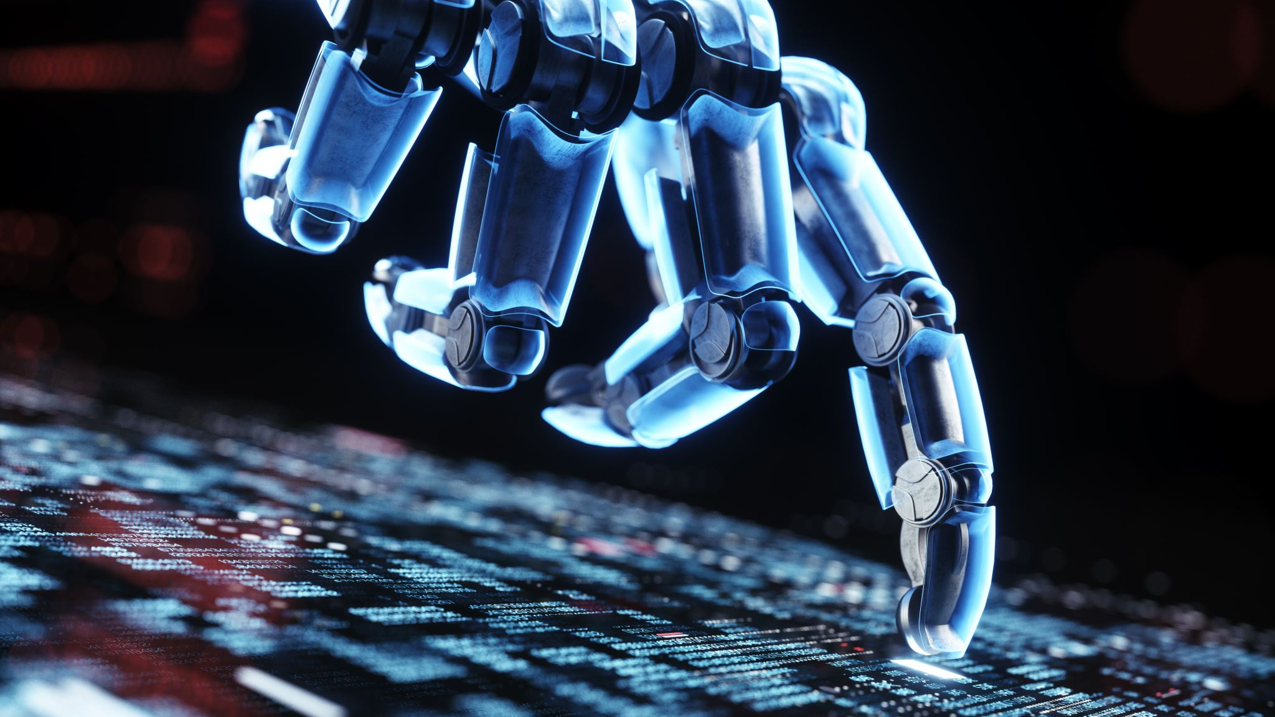
Unmasking Deepfakes: The Role of AI in Detection
Date: October 25, 2024
By: Ashton Dennis

Slide 8

What is a Deepfake?
AI generated image or video
Hard to tell if its fake
Used to spread misinformation
Ever-Improving

Slide 9

What can we do?
Use AI! (If you can’t beat ‘em, join ‘em!)
Trained to detect inconsistencies
Hiya Deepfake Voice Detector
Free Chrome extension
Uses audio of suspected video

Slide 10

Detection is not limited to Deepfakes
Teachers can use AI to detect AI-generated writing.
Bakery in Japan uses AI to distinguish pastries.
Fun Fact: That same AI was also able to detect Cancer cells!

Slide 11
Sources
https://www.pcmag.com/news/this-chrome-extension-will-detect-ai-deepfakes-for-you
https://security.virginia.edu/deepfakes
https://chromewebstore.google.com/detail/hiya-deepfake-voice-detec/akmieeldmgcllmokbpaibfelofjiilpc?pli=1
https://www.newyorker.com/tech/annals-of-technology/the-pastry-ai-that-learned-to-fight-cancer
(Image sources contained within the images themselves.)

Slide 12
Ethics of Artificial Intelligence
Date: October 25, 2024
By: Joseph Gallant

Slide 13
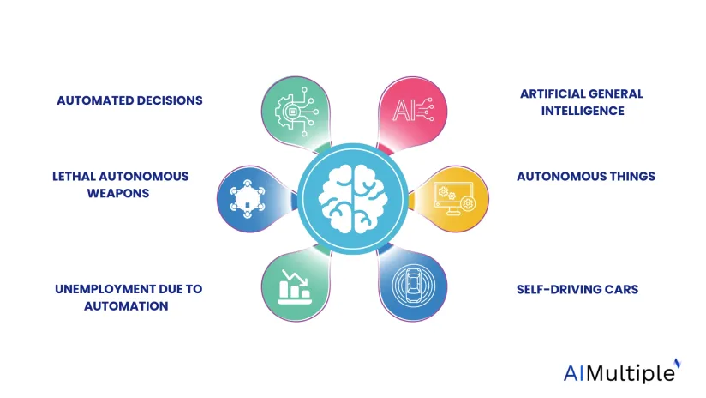
Moral Dilemmas of AI Systems
Accountability for Mistakes
Decision Making for Life-or-Death Situations
Surveillance and Data Privacy
https://research.aimultiple.com/wp-content/uploads/2021/01/ai-ethics-1-824x464.png.webp

Slide 14
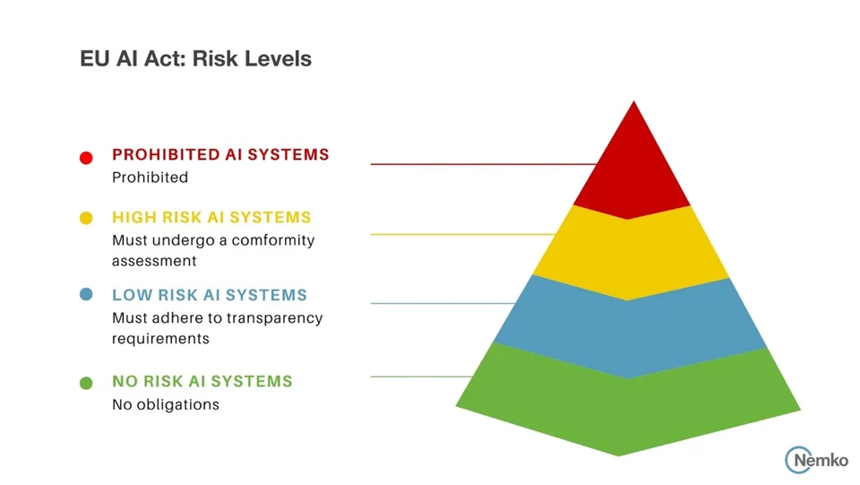
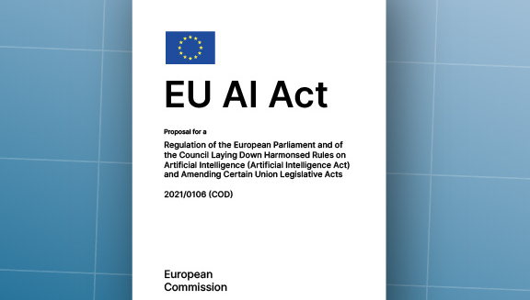
Ethical Guidelines
Establish Regulations for the Use of AI
Fairness
Transparency
Respect for Human Rights
https://www.nemko.com/hs-fs/hubfs/Overview of AI risk levels as defined by the EU AI Act.jpg?width=960&height=541&name=Overview%20of%20AI%20risk%20levels%20as%20defined%20by%20the%20EU%20AI%20Act.jpg
https://artificialintelligenceact.eu/wp-content/uploads/2024/01/EU_AI_Act_Coverpage.jpg

Slide 15
Sources
https://medium.com/@404Guide/the-ethics-of-artificial-intelligence-navigating-the-moral-maze-of-machine-learning-92b98f937874
https://artificialintelligenceact.eu
https://www.nemko.com/blog/a-quick-dive-into-the-eu-ai-act

